Slide 1
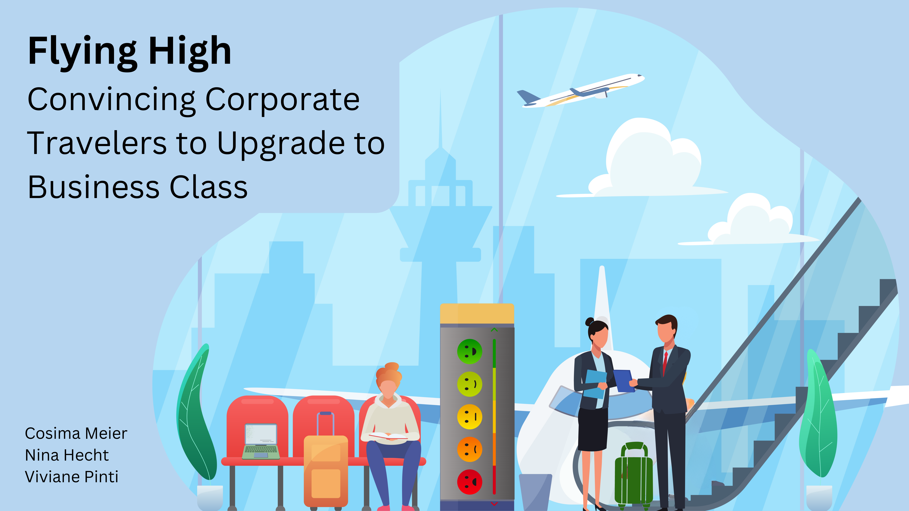
Notes:
Flying High: Convincing Corporate travelers to upgrade to business class
Boost passenger satisfaction and increase profits for your airline by focusing your marketing activities on business class passengers, especially corporate travelers, who generate up to 70% of total profits.
Some corporate travelers choose to fly economy class, however, evidence reveals that the needs of corporate travelers are not fully met in this class. By encouraging them to upgrade, you can capture more profit and enhance their overall satisfaction.
With climate change impacting the number of flights and thereby increasing competition, passenger satisfaction becomes even more vital.
To understand the needs of these valuable customers, we analysed the 'US Airline passenger satisfaction' dataset.

Slide 2
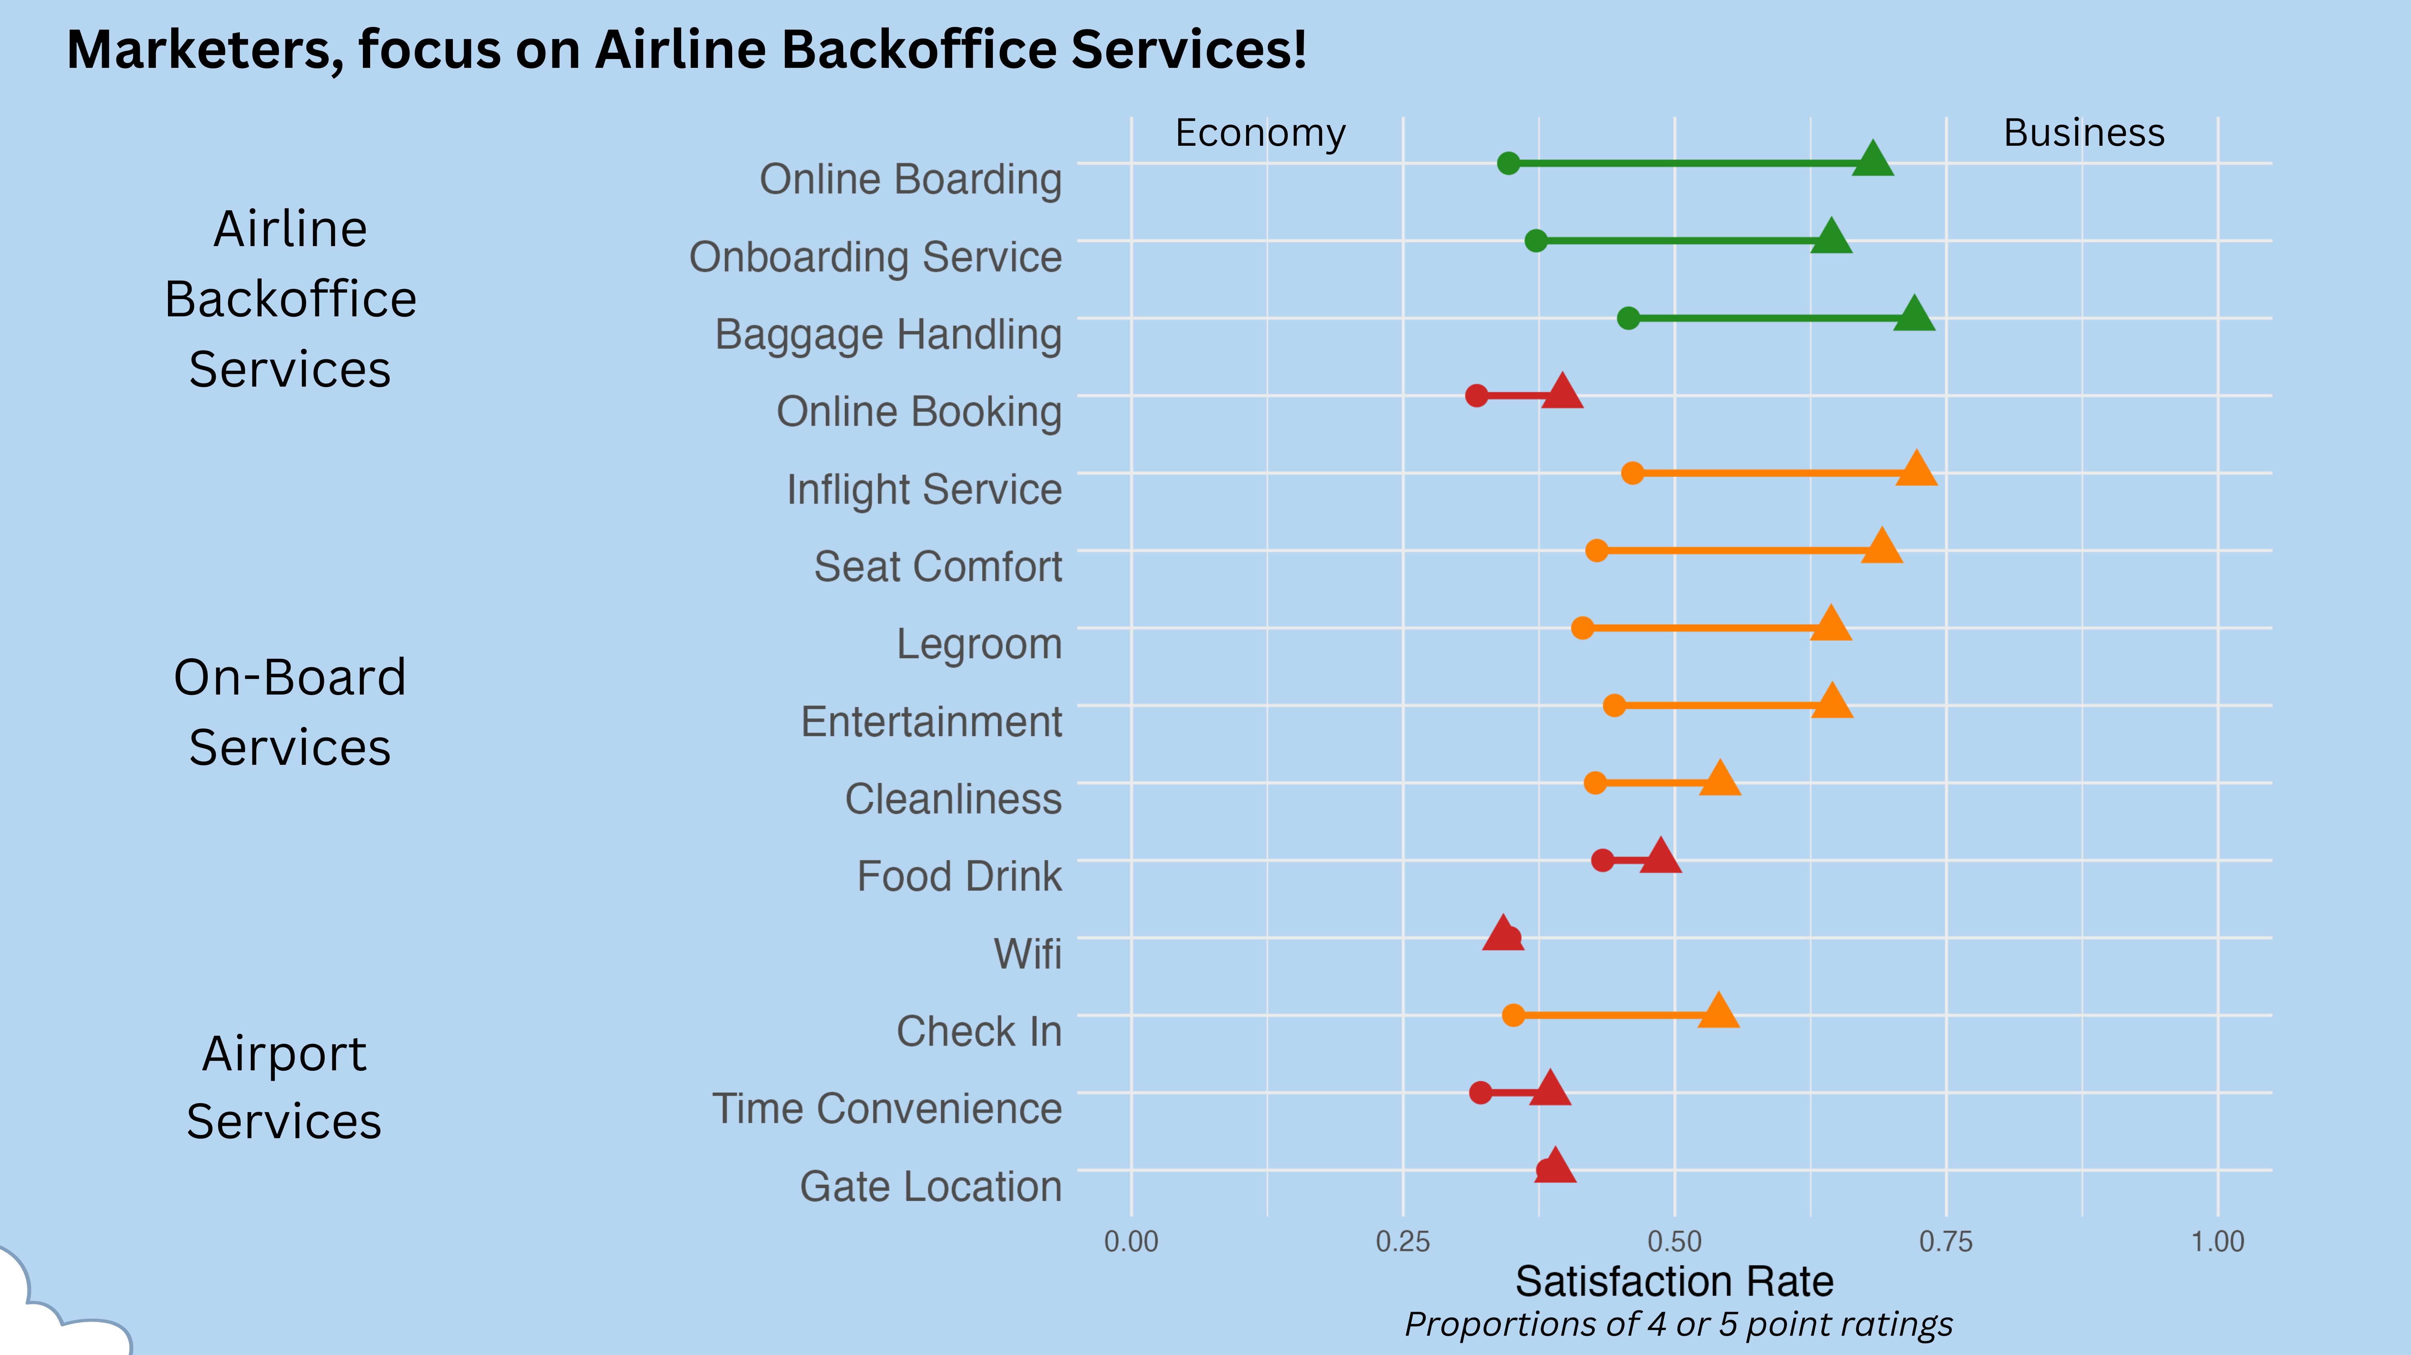

Notes:
Cosima:
Our goal is to identify which services should be marketed to corporate travelers flying economy class to convince them to upgrade to business class.
We evaluated 14 different services, which can be categorized into 3 different categories: Airport Services, On-board Services and Airline Backoffice Services. (show y-Axis with categories)
(show x Axis) Our aim was to find the services with the greatest satisfaction differences between economy and business class.
We computed the percentage of passengers who were very satisfied with a service (rated 4 or 5) and compared these proportions between the two classes.
Nina:
We present our findings in a plot, where services are ranked by the size of the difference in satisfaction levels between economy and business class, which is indicated by the colour gradient (from green to red).
Let's take a closer look at the first service: Online boarding.
About 30% of corporate passengers in economy are very satisfied with online boarding. In business class, however, almost 75% of corporate travelers are very satisfied. So, there is a big difference between the two classes. Hence, corporate travelers in economy could be encouraged to upgrade with marketing activities specifically addressing this service.
We recommend spending the marketing budget on airline backoffice services.
This translates to increased profitability for the airline and higher satisfaction among corporate passengers. It's a win-win scenario.

